Slide 1
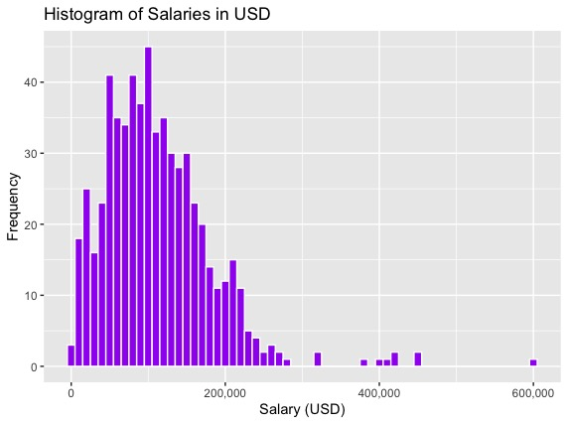
Data Science Salary Analysis: Attracting Top Talent
 | Salary in USD
Minimum | 5,679
Median | 135,000
Mean | 144,055
Maximum | 600,000
Adeline Casali, DSE5002

